Slide 1
Secure Data Hiding in Image Using Steganography
PROJECT TITLE
Presented By:
Student Name : Shubhangi Sundriyal
College Name & Department : Vivekananda Institute of Professional Studies-Technical Campus

Slide 2
OUTLINE
Problem Statement
Technology used
Wow factor
End users
Result
Conclusion
Git-hub Link
Future scope

Slide 3
Problem Statement
In today’s world, keeping messages safe from others is very important. This project helps hide secret messages inside an image by changing some pixel values, making the message invisible to others. Only the person with the correct password can unlock and read the hidden message. This method provides a simple and secure way to send private information without attracting attention.

Slide 4
Technology used
Programming Language: Python
Libraries:
OpenCV (cv2): For image processing and modification
OS: For file handling and opening encrypted images
NumPy: (Implicitly used by OpenCV) for handling pixel data
Platform: Windows OS (Compatible with Linux and macOS as well)
Hardware Requirements:
Standard PC/Laptop with at least 4GB RAM
Processor: Intel Core i3 or higher (or equivalent AMD)
Storage: Minimum 500MB free space for processing and saving images

Slide 5
Wow factors
Simple and Easy to Use – The project provides a straightforward way to hide and retrieve messages without complex encryption methods.
Uses Image Steganography – Instead of regular text encryption, it hides messages inside an image, making them invisible to others.
Password Protection – Only users with the correct password can access the hidden message, adding an extra layer of security.
Lightweight and Fast – The program runs quickly and doesn’t require high-end hardware.
Works on Any Image – The system can embed messages in any standard image format (PNG, JPG, etc.), making it flexible and versatile.

Slide 6
End users
Students & Researchers – For learning and experimenting with data security and steganography techniques.
Journalists & Activists – To securely share sensitive information without drawing attention.
Cybersecurity Enthusiasts – To explore hidden communication methods and understand digital forensics.
Corporate Professionals – For confidential data exchange within organizations.
General Users – Anyone who wants to protect private messages in a simple and effective way.

Slide 7
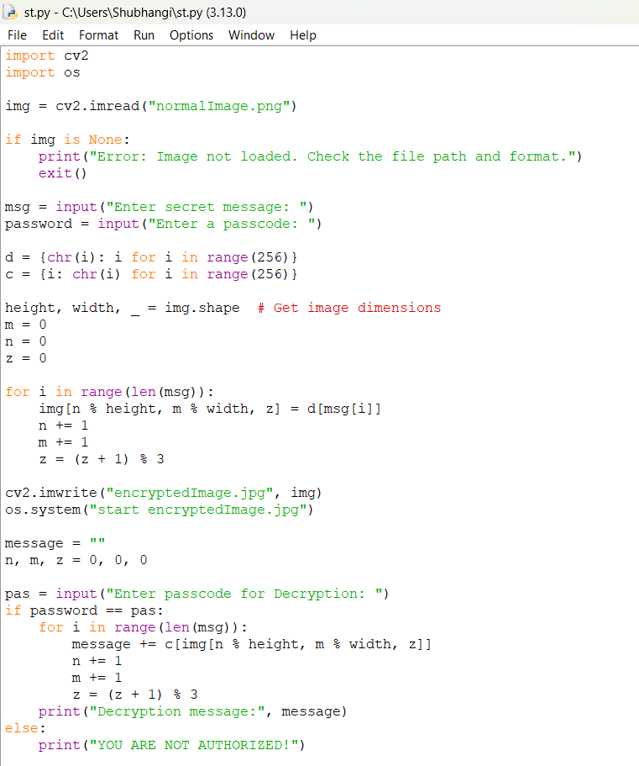
Results

Slide 8
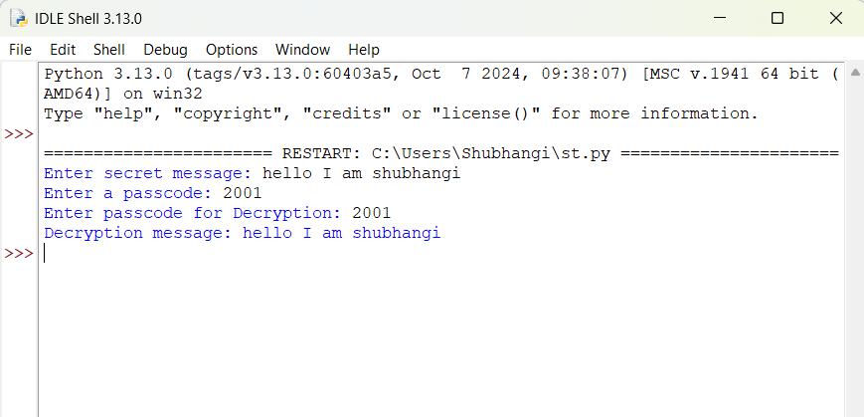
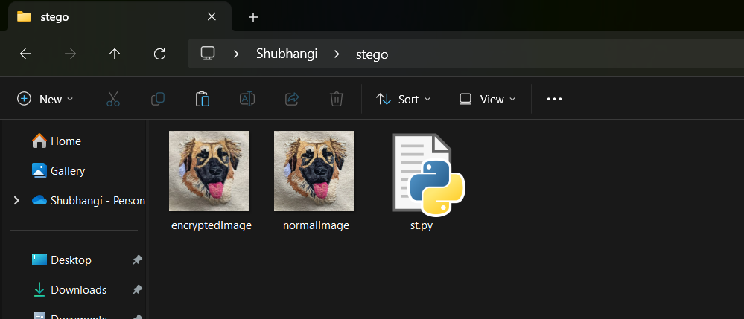

Slide 9
Conclusion
This project successfully implements image steganography, allowing users to securely hide and retrieve messages within an image. By modifying pixel values, the secret message remains undetectable to the naked eye. The use of password protection enhances security, ensuring that only authorized users can decrypt the hidden text.
The project demonstrates the practical application of computer vision and cryptography in secure communication. With further enhancements, such as stronger encryption methods and GUI integration, this project can be made even more user-friendly and robust for real-world use.

Slide 10
GitHub Link
https://github.com/shubhangisundriyal2/img_stego.git

Slide 11
Future scope
✅ Support for longer messages without data loss. ✅ Advanced encryption techniques for better security. ✅ GUI-based interface for ease of use. ✅ Support for multiple image formats and higher resolutions. ✅ Mobile and web-based implementation for wider accessibility.

Slide 12
THANK YOU

